Slide 1
All Hadronic Final States
VVH Events Study
Yanxi Gu
2021.10.18
signal yield is scaled down by 1/0.7, problem fixed after 01.24.2022

Slide 2
_{Outlines}
Purpose of study
Event selections
cutflow table for VVH
showing the event selection criteria used for leptons, jets, and fatjets
show 4 signal channels cutflow, in which H only decays into bb. All combinations of hadronic channels are shown here, for 3/2/1 fatjets and other jets.

Slide 3
_{Purpose of Study}
As we know that if a boson have high Pt, it’s decay particles tend to be reconstructed as fatjets. Our study in this analysis focuses on boosted boson with fatjets.
We take the hadronic channel for study, which contains fatjet, VBS jets and other jets from decay. Some jets may overlap with fatjets, thus cannot be reconstructed, so altogether, events can be classified into 10 categories (9+others).
number of fatjets | 3 | 2 |  |  | 1
number of jets | 2 | 4 | 3 | 2 | 6 | 5 | 4 | 3 | 2

Slide 4
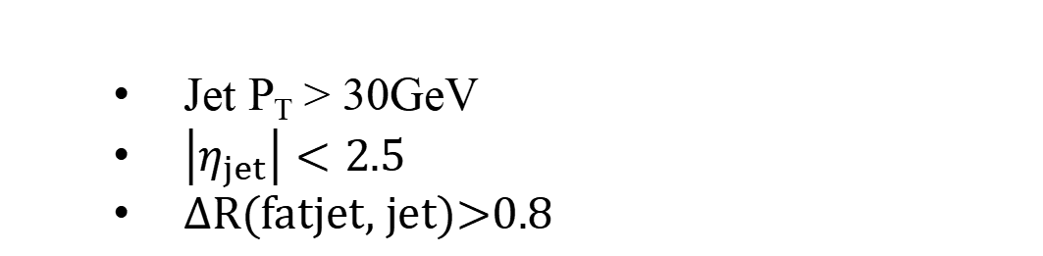
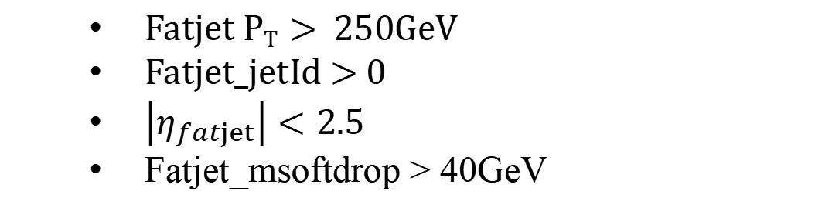
Jet/Fatjet Selection
Fatjet selectrion
  Fatjet P_{T} > 250GeV
  Fatjet_jetId > 0
  $\left|η_{fatjet}\right|<2.5$
  Fatjet_msoftdrop > 40GeV
Jet selectrion
  Jet P_{T} > 30GeV
  $\left|η_{jet}\right|<2.5$
  ΔR(fatjet, jet)>0.8

Slide 5
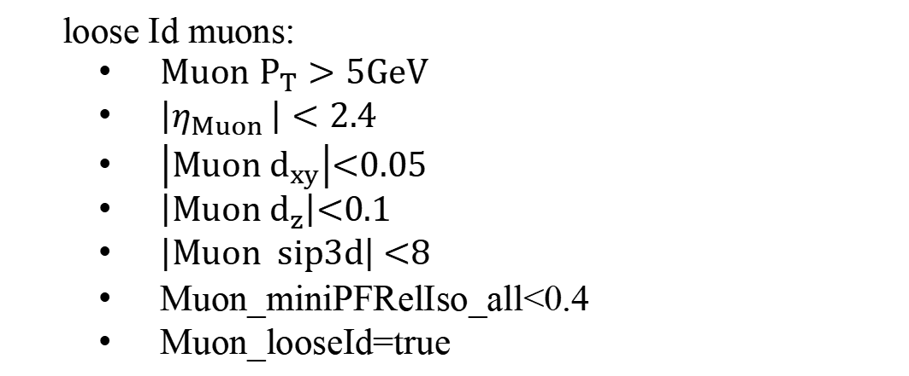
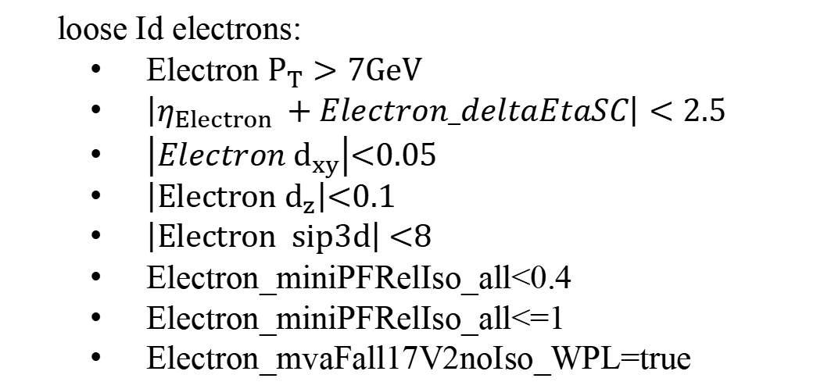
Lepton Selection
Lepton loose Id selectrion (from ttH study)
Electron
loose Id electrons:
  $Electron P_{T}>7GeV$
  $\left|η_{Electron }+Electron_deltaEtaSC\right|<2.5$
  $\left|Electron d_{xy}\right|$<0.05
  $\left|Electron d_{z}\right|$<0.1
  $\left|Electron sip3d\right|$ <8
  Electron_miniPFRelIso_all<0.4
  Electron_miniPFRelIso_all<=1
  Electron_mvaFall17V2noIso_WPL=true
Muon
loose Id muons:
  $Muon P_{T}>5GeV$
  $\left|η_{Muon }\right|<2.4$
  $\left|Muon d_{xy}\right|$<0.05
  $\left|Muon d_{z}\right|$<0.1
  $\left|Muon sip3d\right|$ <8
  Muon_miniPFRelIso_all<0.4
  Muon_looseId=true
We require the number of leptons passing these selections should be 0

Slide 6
Cut flow for VVH
Entries comparison
 |  | SS WWH | OS WWH | WZH | ZZH
total number of events weighted to 137 fb⁻¹ |  | 711.03 | 1127.51 | 735.69 | 580.88
Select Hbb at Gen level |  | 409.18 | 648.18 | 422.73 | 334.45
0 lepton |  | 236.48 | 377.76 | 289.75 | 270.04
3+ fatjet | 3+ fatjets | 29.13 | 34.12 | 27.53 | 22.02
 | 2+ jets | 9.98 | 12.46 | 9.78 | 7.51
 | 1 jet | 15.00 | 17.09 | 14.00 | 11.29
 | 0 jet | 4.15 | 4.58 | 3.75 | 3.22
2 fatjet | 2 fatjets | 88.76 | 126.53 | 97.25 | 90.52
 | 4+ jets | 16.69 | 24.70 | 17.97
 |  |  |  |  | 14.88
 | 3 jets
 |  | 27.31
 |  |  | 38.16
 |  |  |  | 27.97
 |  |  |  |  | 23.94
 | 2 jets | 29.46 | 40.83 | 30.33
 |  |  |  |  | 27.12
 | <2 jets | 15.30 | 22.84 | 20.97 | 24.58
cross section | 5.19 fb | 8.23 fb | 5.37 fb | 4.24 fb

Slide 7
Cut flow for VVH
Entries comparison
 |  | SS WWH | OS WWH | WZH | ZZH
1 fatjet | 1 fatjet | 66.52 | 107.12 | 89.03 | 90.67
 | 6+ jets | 8.56 | 15.42 | 10.51 | 8.65
 | 5 jets | 14.10 | 23.83 | 16.53 | 14.21
 | 4 jets
 |  | 20.85
 |  |  | 32.77
 |  |  |  | 24.06
 |  |  |  |  | 21.43
 | 3 jets | 16.16 | 24.81 | 22.17 | 23.49
 | 2 jets | 5.87 | 8.92 | 12.16 | 15.48
 | <2 jets | 0.98 | 1.37 | 3.60 | 7.41
none of the above |  | 52.07 | 109.99 | 75.94 | 66.82
cross section | 5.19 fb | 8.23 fb | 5.37 fb | 4.24 fb
*None of the above means, no fatjet

